Slide 1
Introduction to Hypothesis Testing
One and two sample t tests

Slide 2
Learning Objectives
This presentation explores the principles of hypothesis testing and introduces to students the language and the rationale behind this concept.
Typical questions that are answered using this technique are the ones like:
-Does the sample represent the population
-What confidence can be assigned to this conclusion
-Could we compare two different samples and conclude something about them
Learning objectives:
Introduce parametric hypothesis testing.
Understand and differentiate between one-tail and two tail testing, one-sample and two-sample, dependent and independent samples, different types of distributions and concept of Type I and II error.
Solve data problems using Excel and SPSS.

Slide 3
Parametric vs non-parametric (1/3)
To make the generalization about the population from the sample, statistical tests are used. A statistical test is a formal technique that relies on the probability distribution, for reaching the conclusion concerning the reasonableness of the hypothesis. These hypothetical testing related to differences are classified as parametric and nonparametric tests.
Comparison | Parametric test | Non-parametric test
What it means? | A statistical test, in which specific assumptions are made about the population parameter is known as a parametric test. | A statistical test, in which specific assumptions are not made about the population parameter is known as a non-parametric test.
Distribution known? | Yes | Arbitrary
Measurement level? | Interval, ratio, nominal, ordinal | Nominal or ordinal
Measure? | Mean, proportion | Median
Information about population data? | Known | Unknown
Test applied to? | Variables | Variables and attributes
Table 6.1 provides a comparison between the two types of test

Slide 4
Parametric vs non-parametric (2/3)
Parametric tests
The parametric test is the hypothesis test which provides generalizations for making statements about the mean of the parent population.
Non-parametric tests
The nonparametric test is defined as the hypothesis test, which is not based on underlying assumptions, i.e. it does not require a population’s distribution to be denoted by specific parameters.
The test is mainly based on differences in medians. Hence, it is alternately known as the distribution-free test.
The test assumes that the variables are measured on a nominal or ordinal level.

Slide 5
Parametric vs non-parametric (3/3)
Analysis required | Parametric test (means) | Book chapter | Non-parametric test (medians) | Book chapter
Compare a sample average against a constant | 1 sample t test | 6 | Sign test One sample Wilcoxon test | 7
Compare two independent sample averages | Two sample t test for independent samples | 6 | Mann-Whitney test | 7
Compare two dependent sample averages | Two sample t test for dependent samples | 6 | Wilcoxon rank sum test | 7
Compare three or more independent sample averages | One-way ANOVA | Online | Kruskal-Wallis test | Online
Compare three or more dependent sample averages | Factorial ANOVA | Online | Friedman test | Online
Estimate the degree of association between two quantitative variables | Pearson coefficient of correlation | 8 | Spearman’s rank correlation | 8

Slide 6
Assumptions (1/4)
In general, the parametric one sample z test assumptions are as follows:
The sample is a simple random sample from a defined population.
Independence – the behaviour of one participant does not influence the behaviour of another participant. In repeated measure comparisons (in which participants are measured in more than one experimental condition), we would expect test values to be non-independent for each participant, but the values achieved by different participants should not influence the score from the other participants.
The mean is known or assumed to be known.
It is assumed that the variables of interest in the population are measured on an interval/ratio scale.
The population standard deviation is known.
Variable being measured is normally distributed in the population.

Slide 7
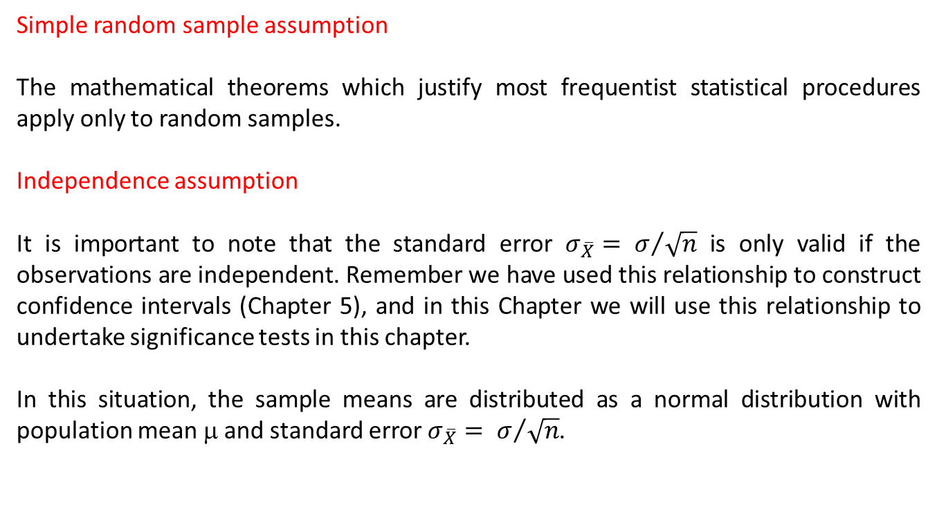
Assumptions (2/4)
Simple random sample assumption
The mathematical theorems which justify most frequentist statistical procedures apply only to random samples.
Independence assumption
It is important to note that the standard error ${σ_{\overline{X}}= σ}/{\sqrt{n}}$ is only valid if the observations are independent. Remember we have used this relationship to construct confidence intervals (Chapter 5), and in this Chapter we will use this relationship to undertake significance tests in this chapter.
In this situation, the sample means are distributed as a normal distribution with population mean μ and standard error ${σ_{\overline{X}}= σ}/{\sqrt{n}}$.

Slide 8
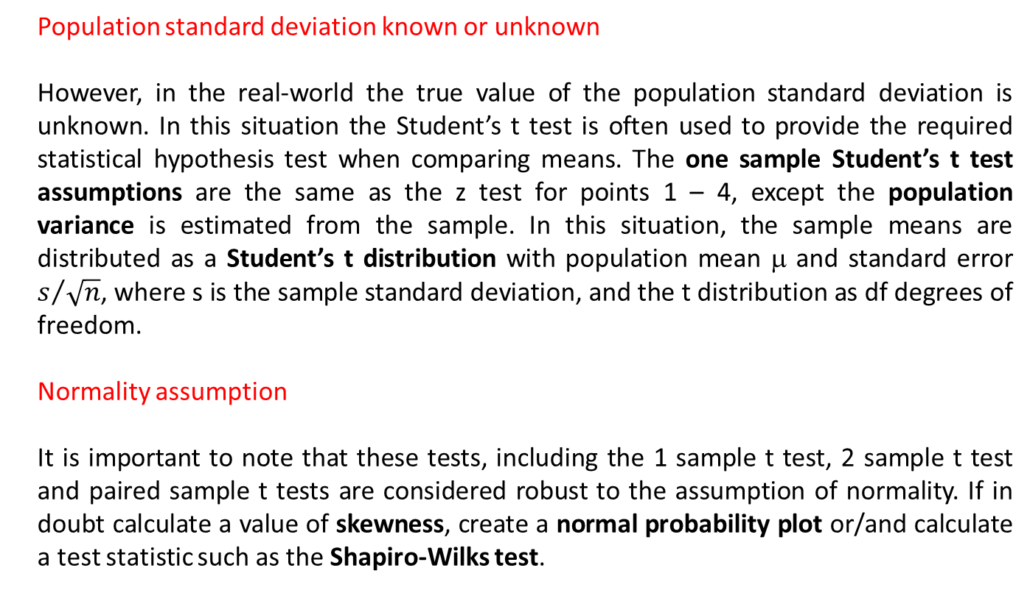
Assumptions (3/4)
Population standard deviation known or unknown
However, in the real-world the true value of the population standard deviation is unknown. In this situation the Student’s t test is often used to provide the required statistical hypothesis test when comparing means. The one sample Student’s t test assumptions are the same as the z test for points 1 – 4, except the population variance is estimated from the sample. In this situation, the sample means are distributed as a Student’s t distribution with population mean μ and standard error $s/{\sqrt{n}}$, where s is the sample standard deviation, and the t distribution as df degrees of freedom.
Normality assumption
It is important to note that these tests, including the 1 sample t test, 2 sample t test and paired sample t tests are considered robust to the assumption of normality. If in doubt calculate a value of skewness, create a normal probability plot or/and calculate a test statistic such as the Shapiro-Wilks test.

Slide 9
Assumptions (4/4)
A further assumption is required for two sample t tests depending upon whether the samples ae independent or dependent:
Two sample independent t-test assumptions - homogeneity of variance – variances should be the same for each independent group being compared. A description of Hartley’s Fmax and Levene’s test is available online together with the Excel or SPSS solutions.
Two sample dependent t-test assumptions - (i) Population data normally distributed, (ii) The difference between the paired values are normally distributed.

Slide 10
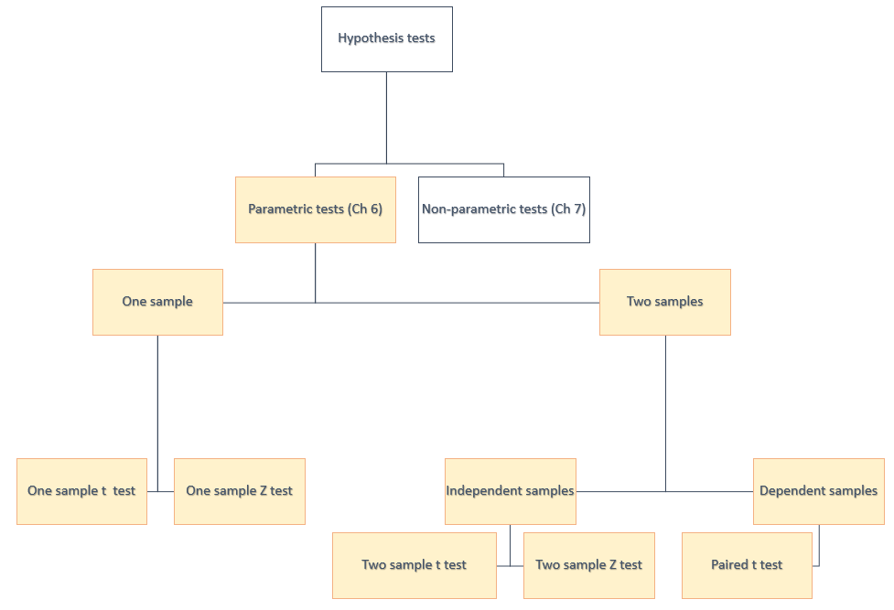
Which test to apply?

Slide 11
Hypothesis testing procedure
Hypothesis testing – 5 steps
Step 1 | Provide the formal hypothesis statements H₀ and H₁
Step 2 | Determine the test to apply for the given hypothesis statement
Step 3 | Set the level of significance a
Step 4 | Extract relevant statistic
Step 5 | Make a decision

Slide 12
How to make decisions?
Two approaches to accept/reject hypothesis: 1) Use the p-value or 2) Calculate the test statistic and compare with a critical test statistic.
The p-value represents the probability of the calculated random sample test statistic being this extreme if the null hypothesis is true. This p-value can then be compared to the chosen significance level (α) to make a decision between accepting or rejecting the null hypothesis H₀.
If p < α, then we would reject the null hypothesis H₀ and accept the alternative hypothesis H₁.
A different approach to using the p-value is to calculate the test statistic and compare the value with a critical test statistic estimate from an appropriate table or via Excel. The value of the critical test statistic will depend upon the following factors: (i) significance level for z test problems, and (ii) the significance level and number of degrees of freedom for t test problems.
If test statistic > critical test statistic then we would reject the null hypothesis H₀ and accept the alternative hypothesis H₁.

Slide 13
Conclusion
In this presentation we explored the concept of hypothesis testing:
Introduction to hypothesis testing
Difference between sample tests
Types of errors in hypothesis testing
Difference between one-tail and two-tail tests

